Slide 1

The Penguins Team
CourseKata Data Set
Karim Rizk, Mitchell Dolny, Peter Kuvshinov

Slide 2
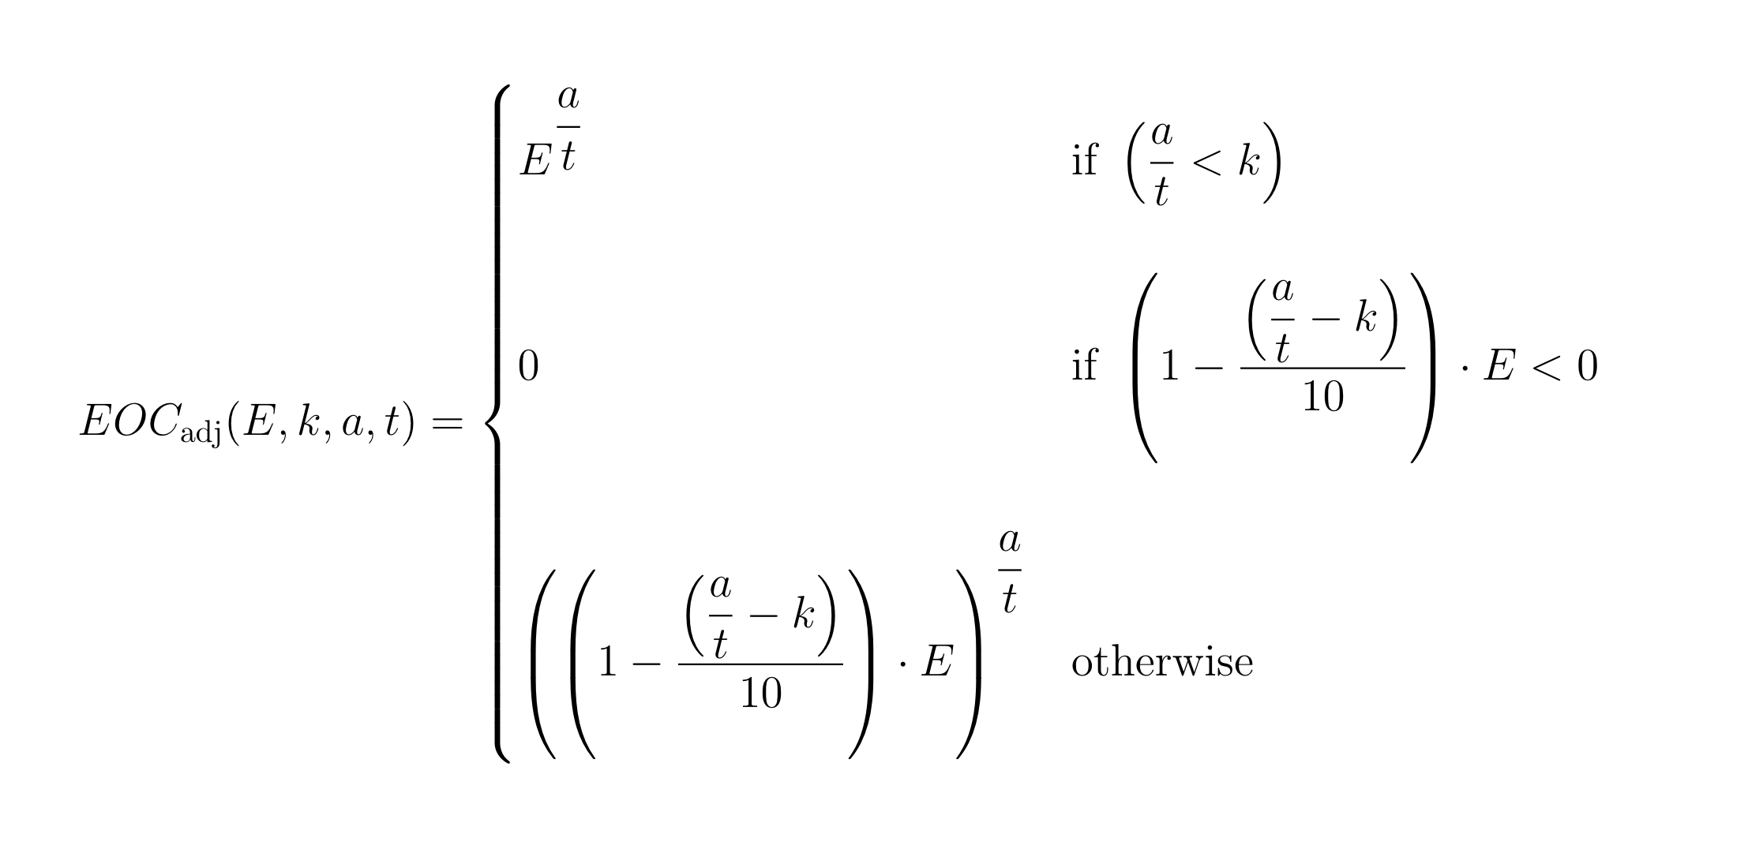
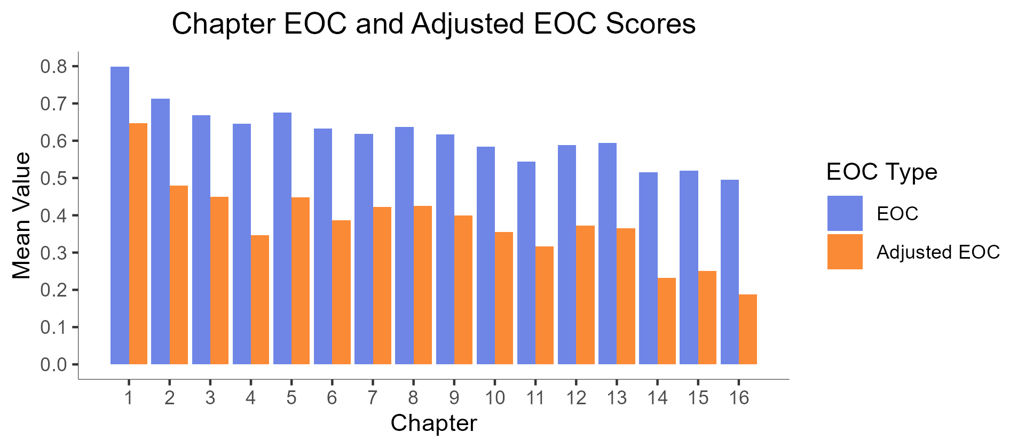
E: Unadjusted EOC
k: Threshold (1.5 in our use)
a: The Number of Point Attempts
t: The Total Number of Possible Points

Slide 3
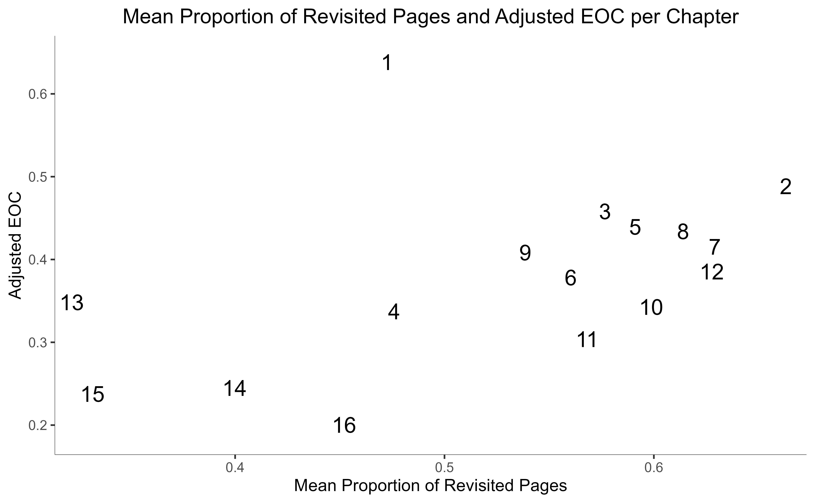
Covariate | Pr(>F)
Average Engagement Time per Section (in minutes) | 0.105008
Average Number of Attempts per Question in each Chapter | 0.000208
Binary Variable Indicating if a Chapter contains Videos | 0.176180
Average of the Proportion of Revisited Pages in each Chapter | 0.00537

